Slide 1
THE ULTIMATE OPTION
FOR RENOVATION
WE GIVE LIFE & SHAPE TO YOUR IMAGINATION
GFRC FACADES

Slide 2
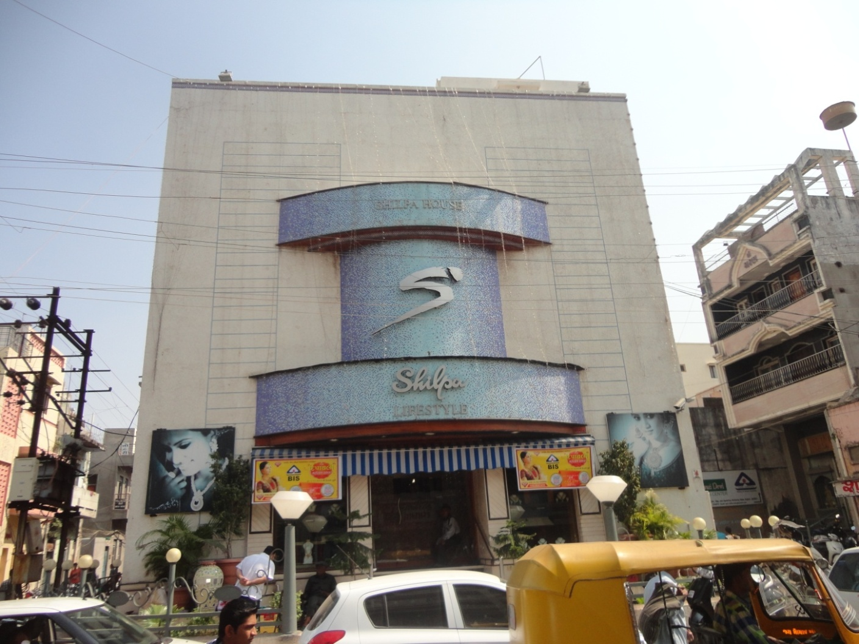
SHILPA JEWELLERS -RAJKOT

Slide 3
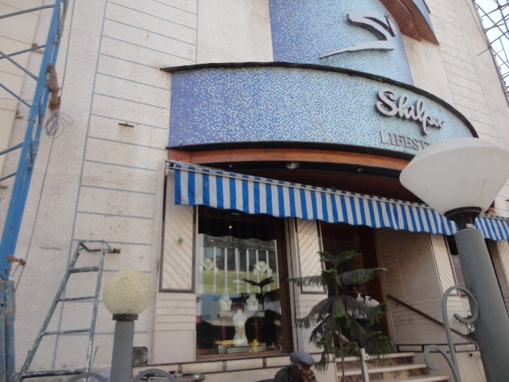
SHILPA JEWELLERS -RAJKOT

Slide 4
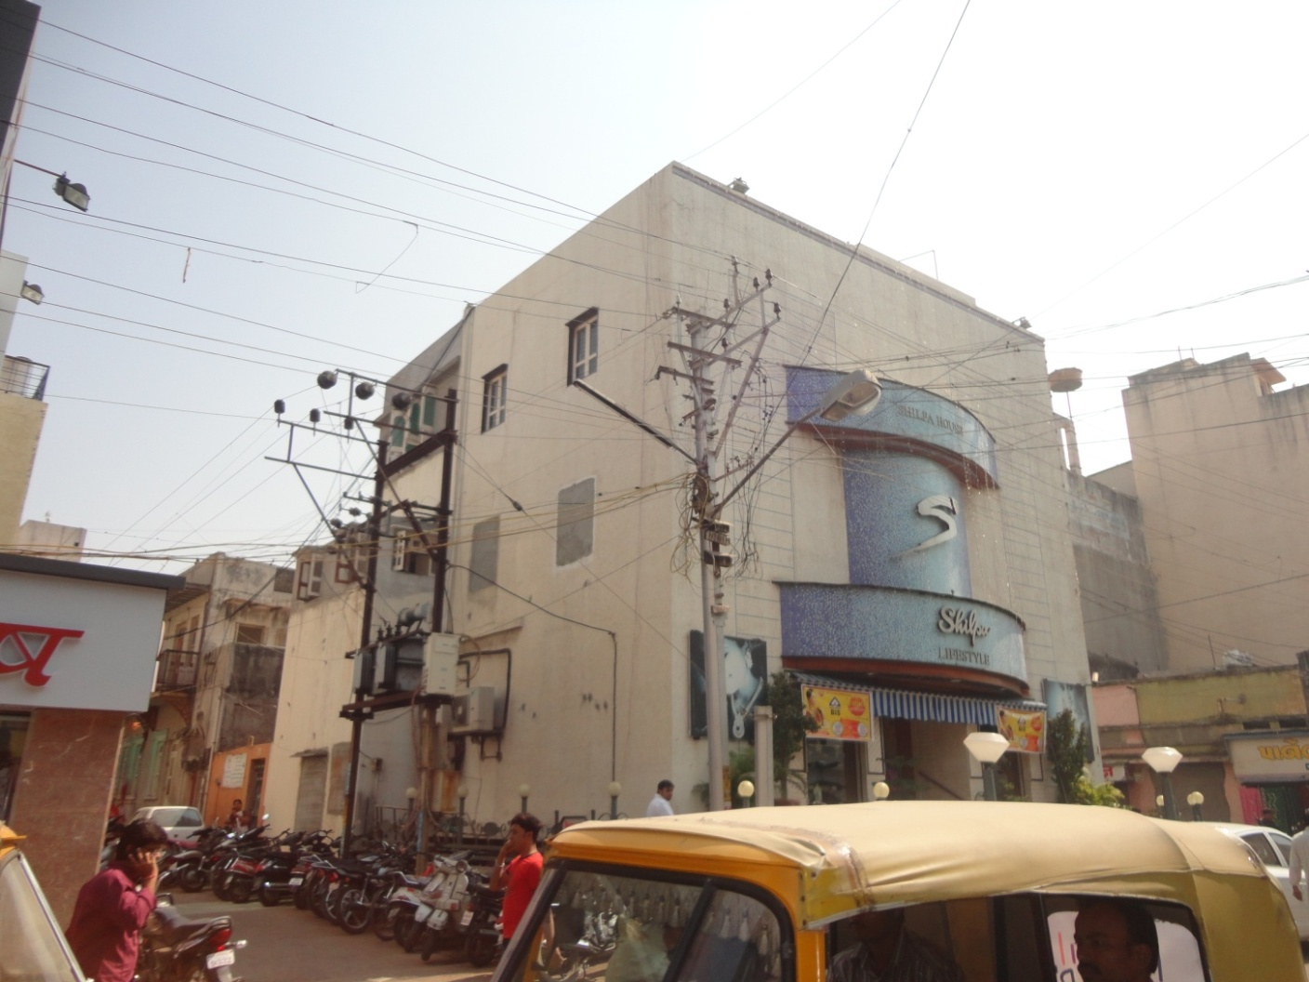
SHILPA JEWELLERS -RAJKOT

Slide 5
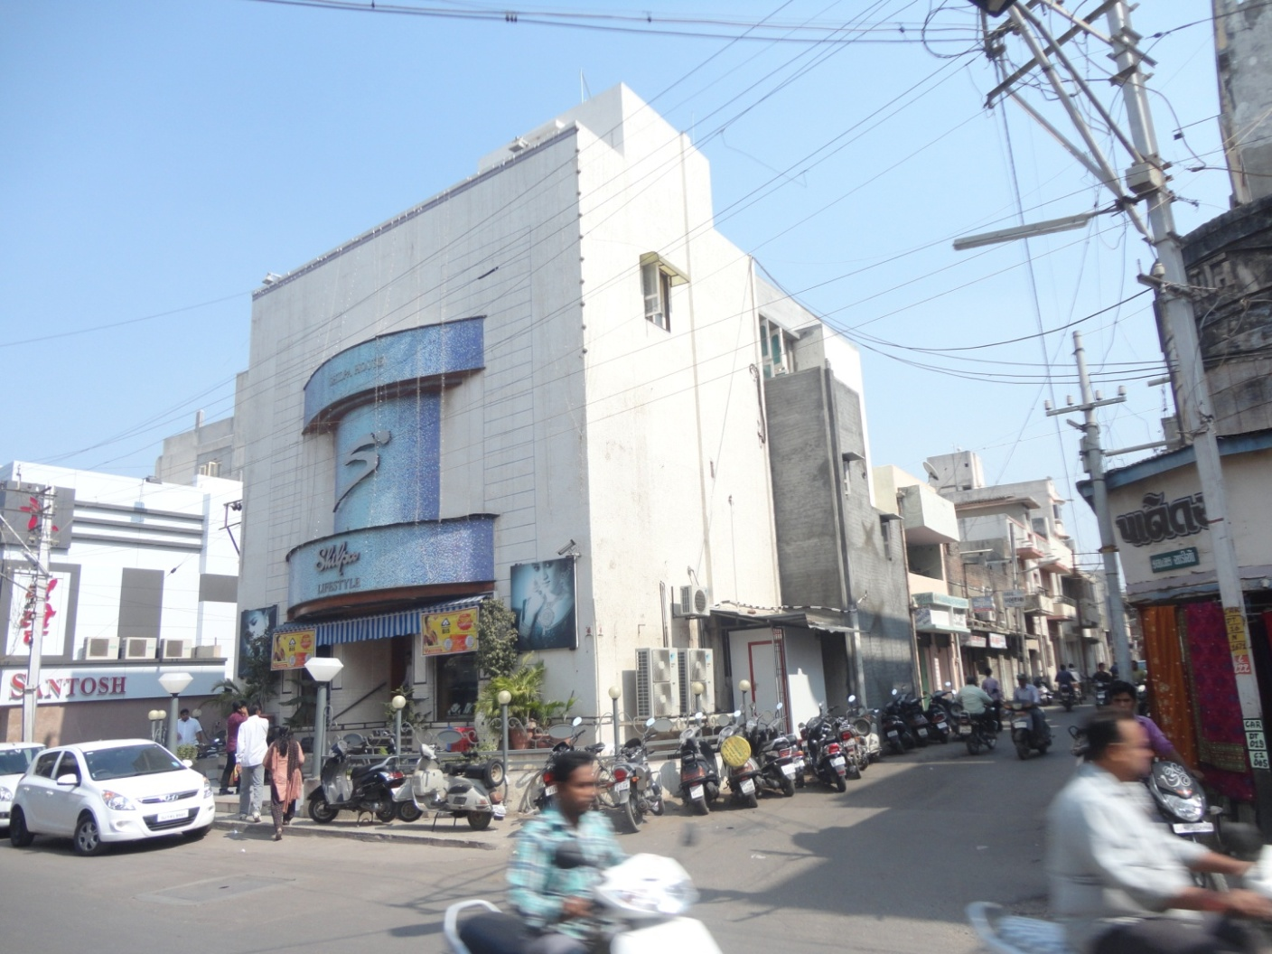
SHILPA JEWELLERS -RAJKOT

Slide 6
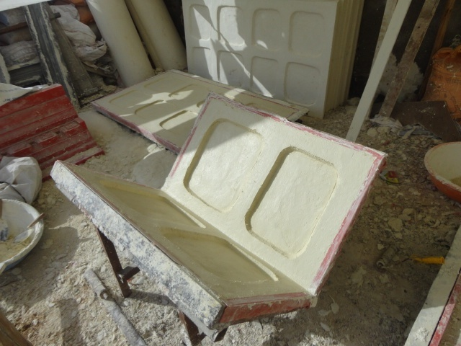
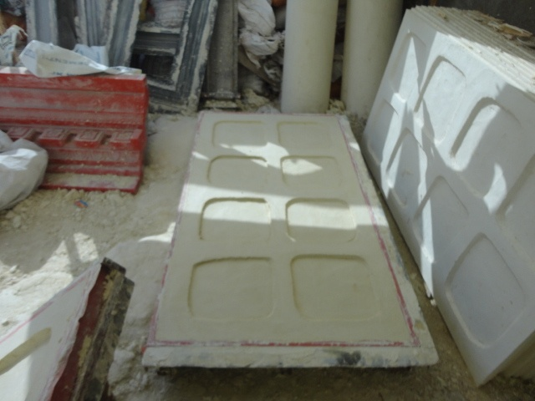
CASTING OF PANELS
CORNER & PLAIN FLAT PANELS

Slide 7
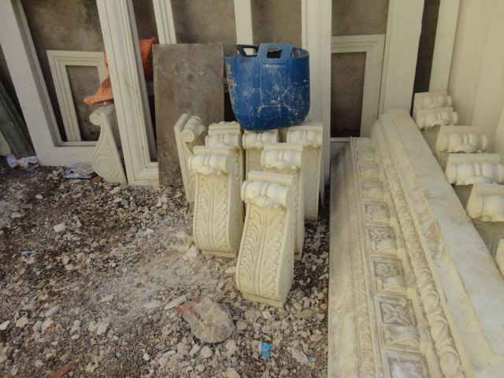
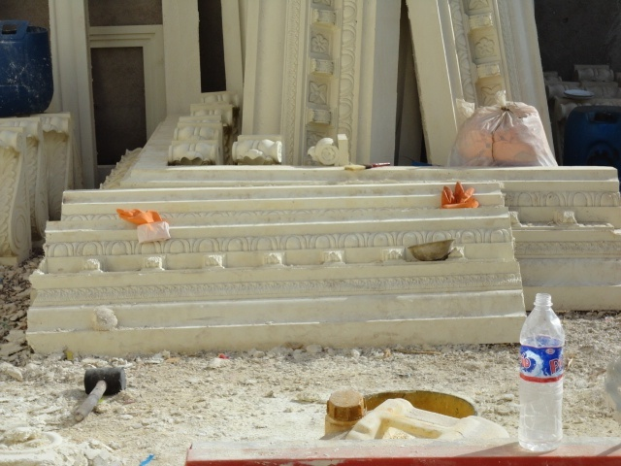
BRACKETS & CORNICE

Slide 8
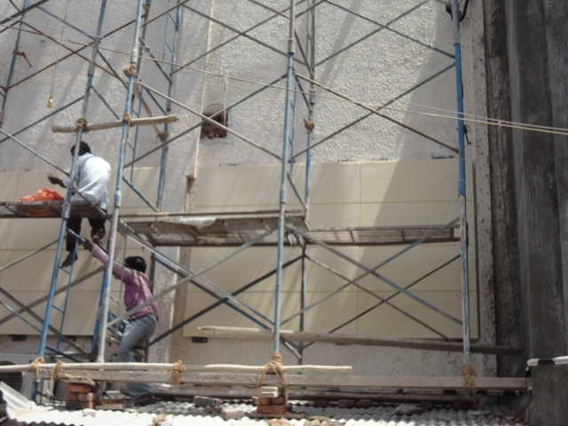
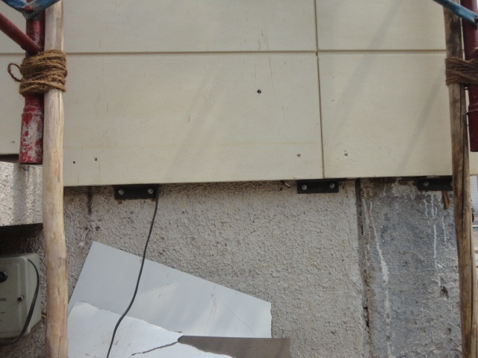
CLADDING OF GRC PANELS

Slide 9
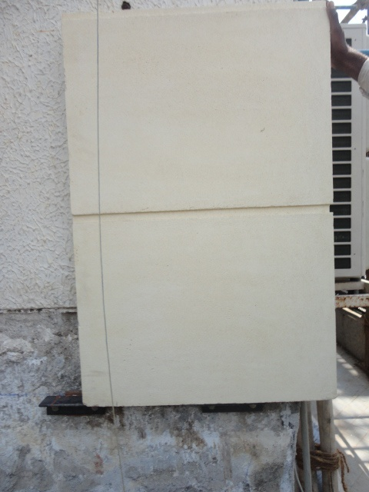
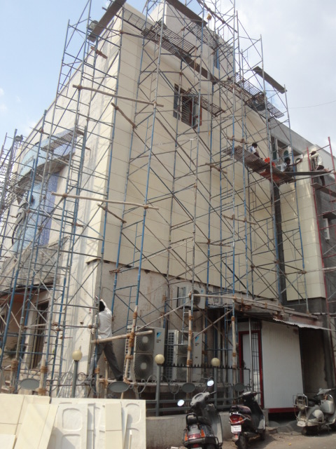
CORNER PANELS BEING FIXED

Slide 10
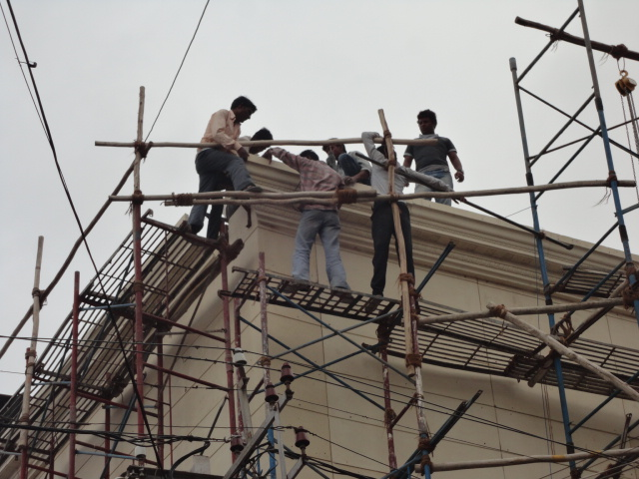
CORNICE FIXING

Slide 11
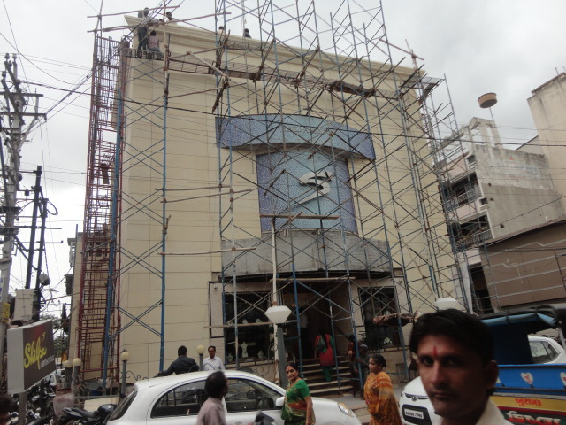
CORNICE FIXING

Slide 12
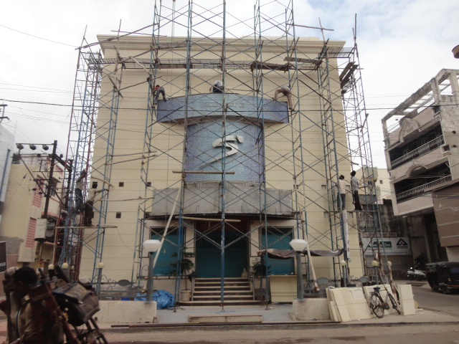
CORNICE FIXING

Slide 13
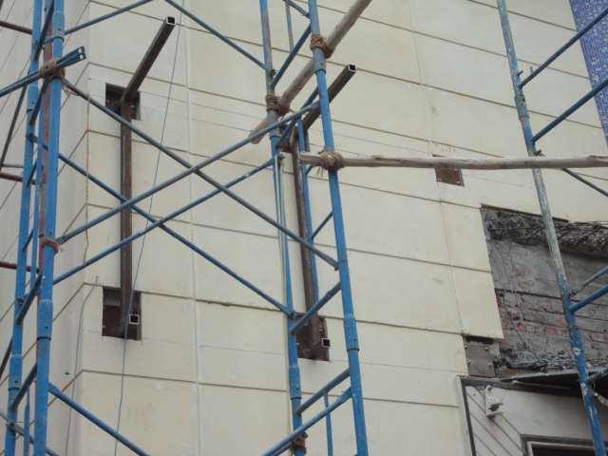
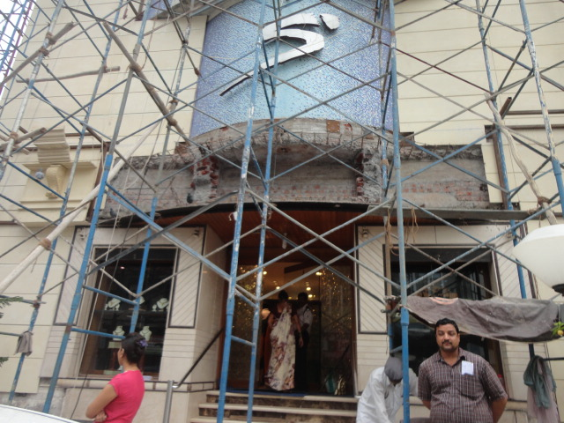
STEEL FRAMEWORK
FOR CORNICE & BRACKET FIXING

Slide 14
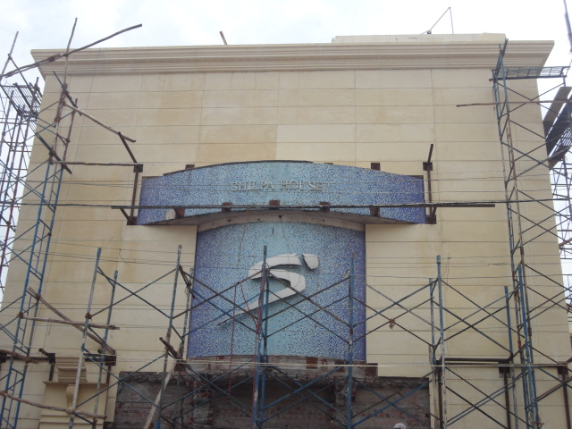
FIXING OF PLAIN PANELS

Slide 15
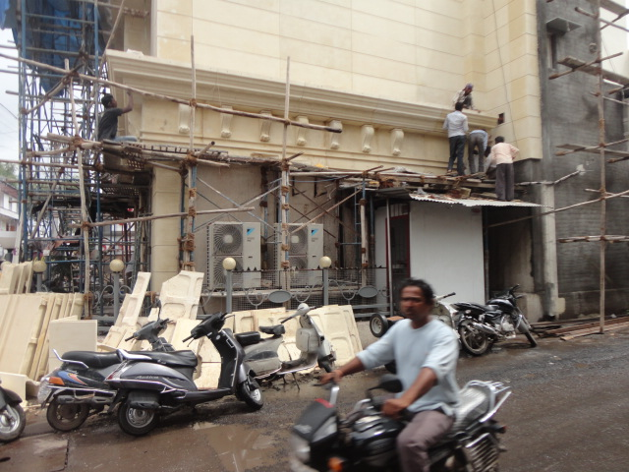
BRACKET FIXED BETWEEN CORNICE

Slide 16
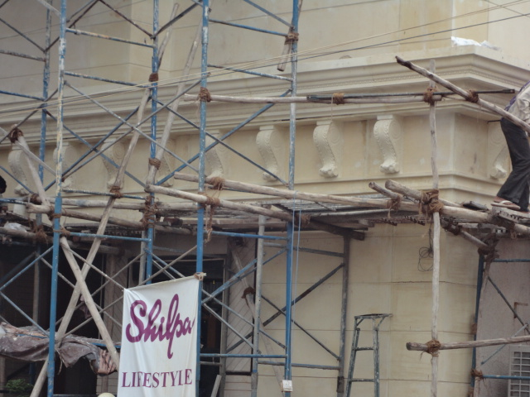
BRACKET FIXED BETWEEN CORNI

Slide 17
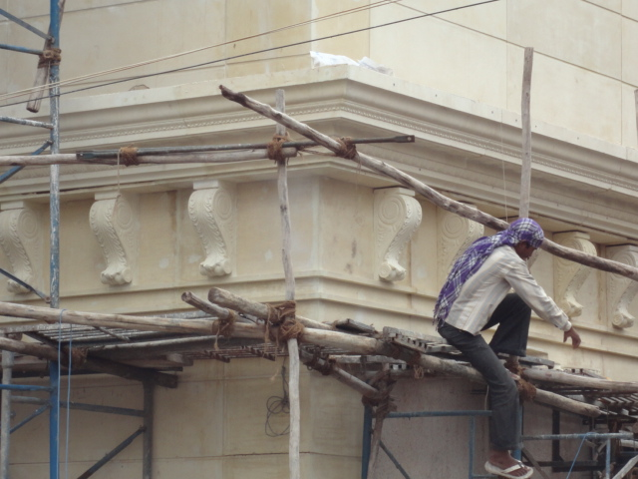
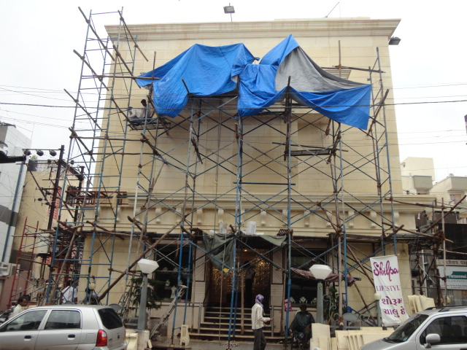
BRACKET FIXED BETWEEN CORNICE

Slide 18
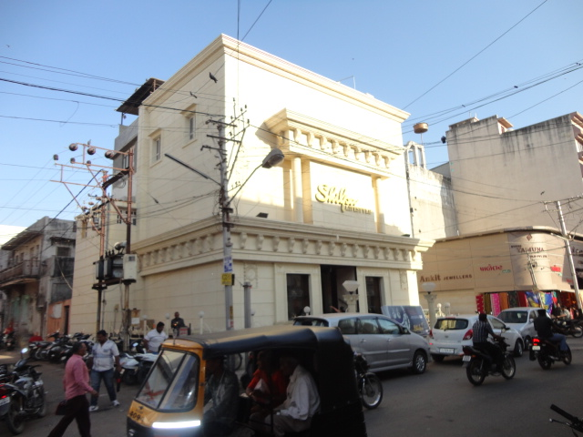
THE CHANGE OVER

Slide 19
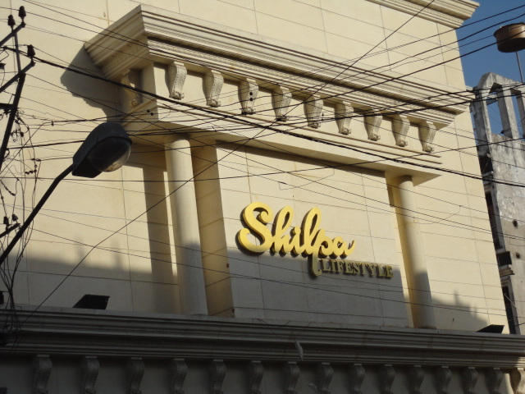
COLUMN, BRACKETS, CORNICE & PANELS

Slide 20
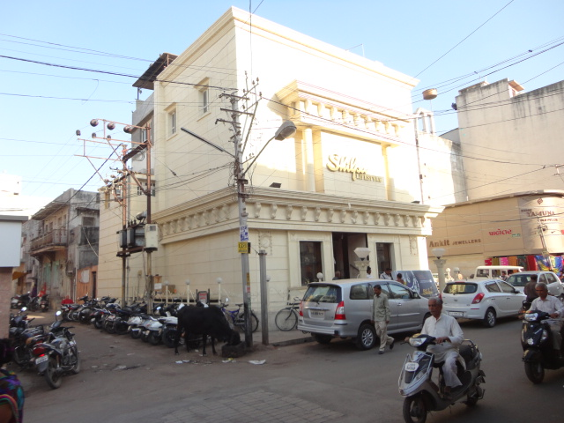
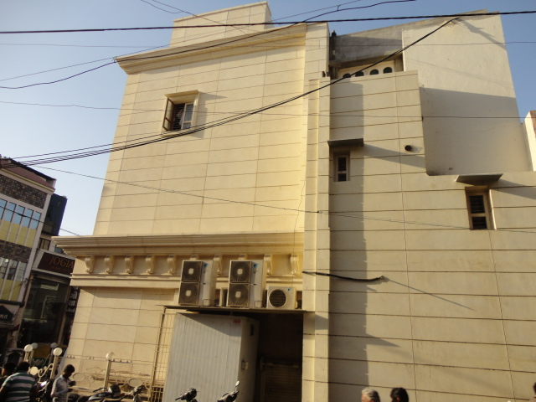
THE GRC PANEL

Slide 21
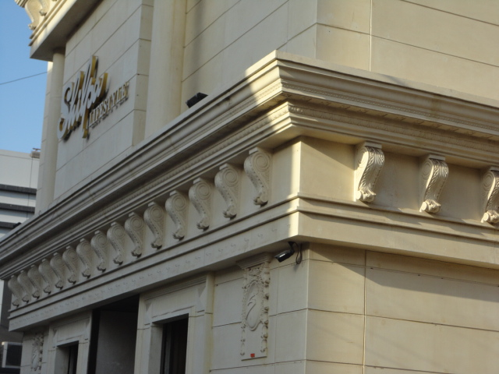
COLUMN, BRACKETS, CORNICE & PANELS

Slide 22
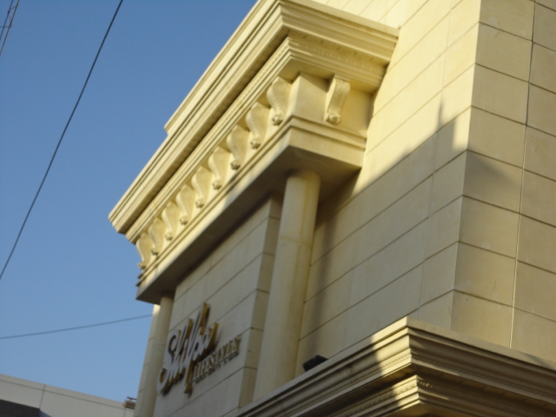
COLUMN, BRACKETS, CORNICE & PANELS

Slide 23
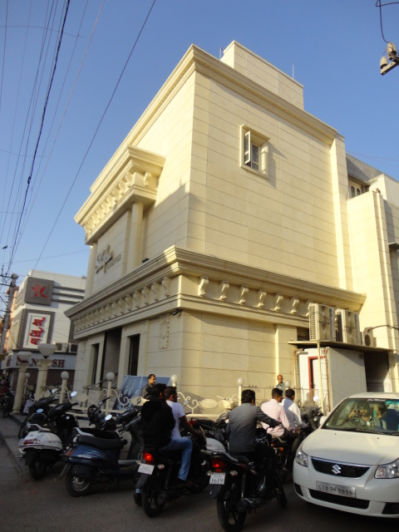
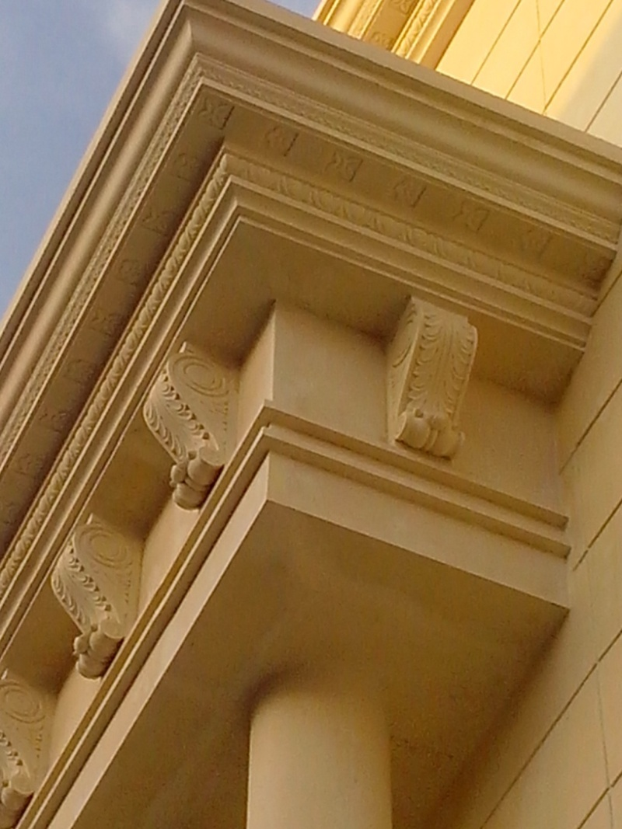
PANEL, CORNICE & BRAKETS

Slide 24
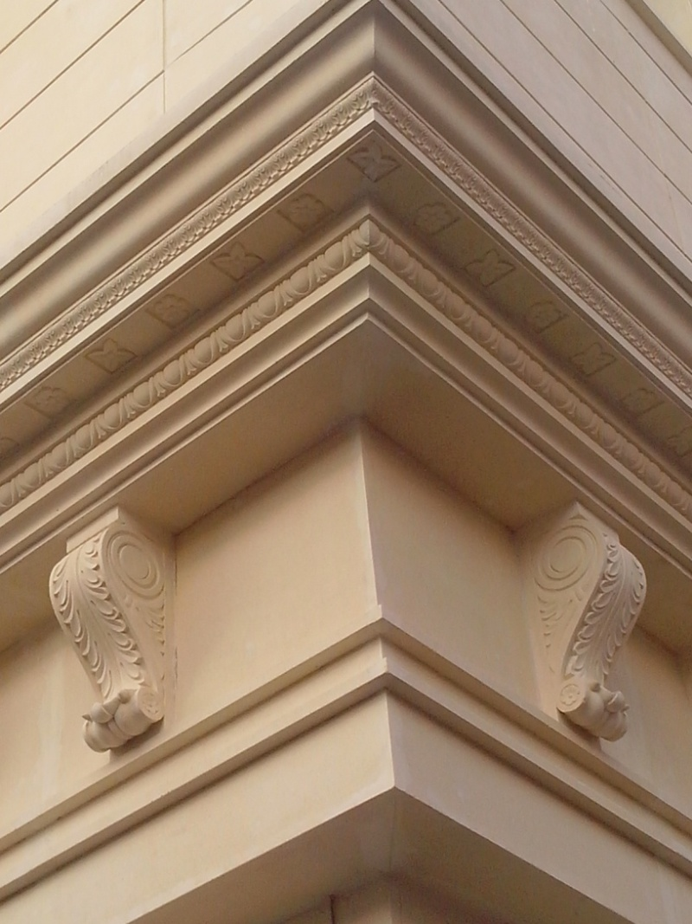
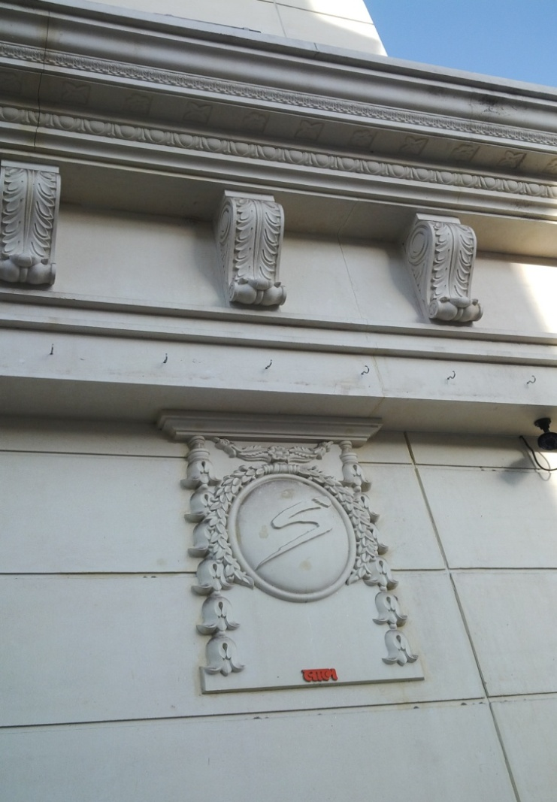
THE LOGO, CORNICE & BRACKET

Slide 25
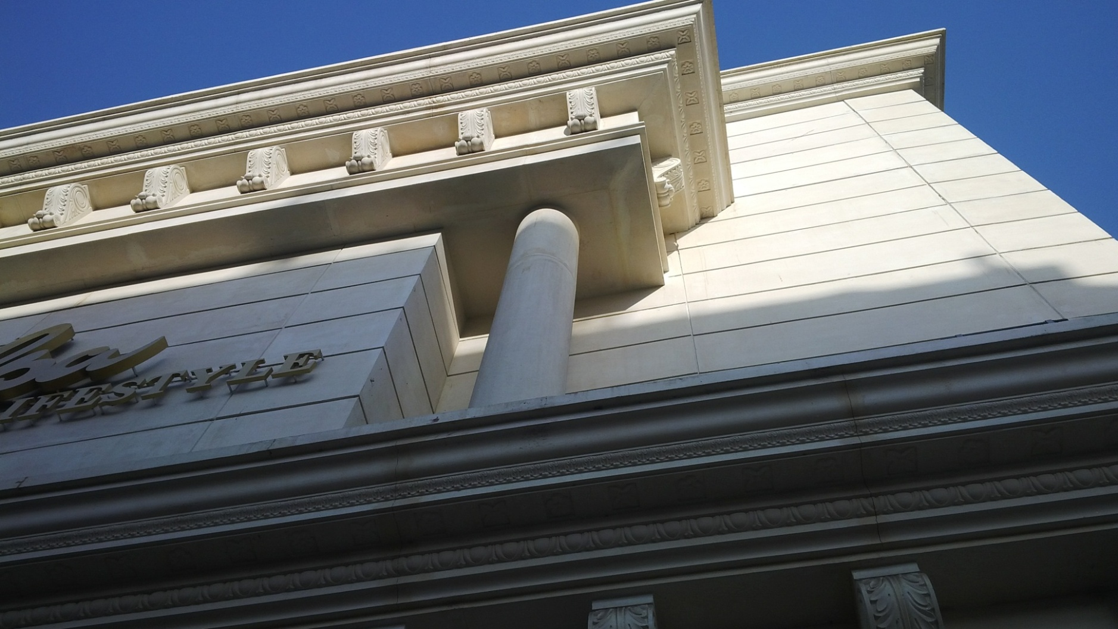
COLUMN, BRACKETS, CORNICE & PANELS

Slide 26
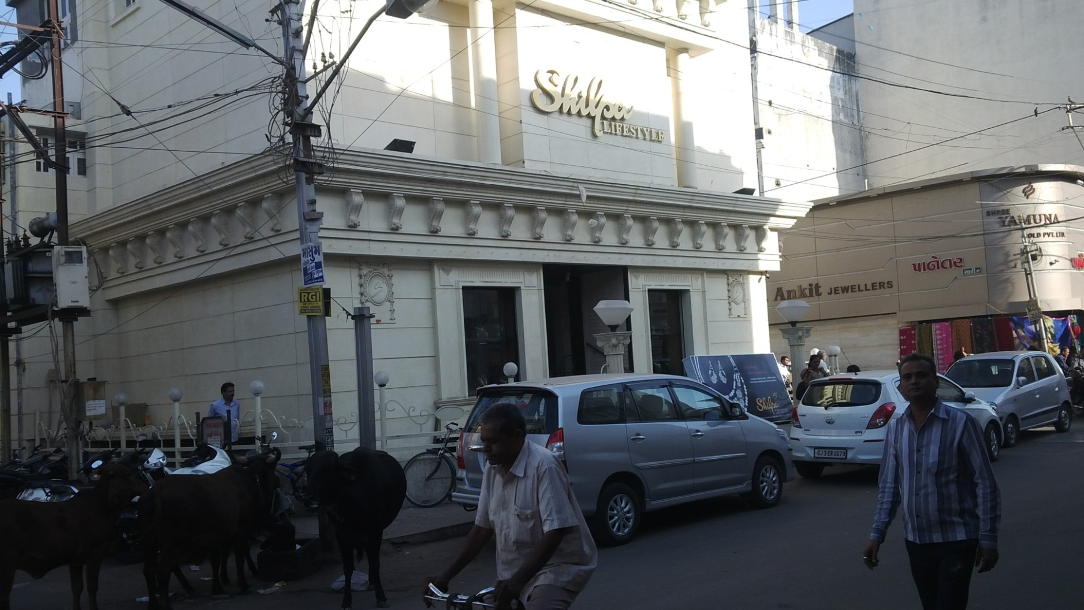
COLUMN, BRACKETS, CORNICE & PANELS

Slide 27
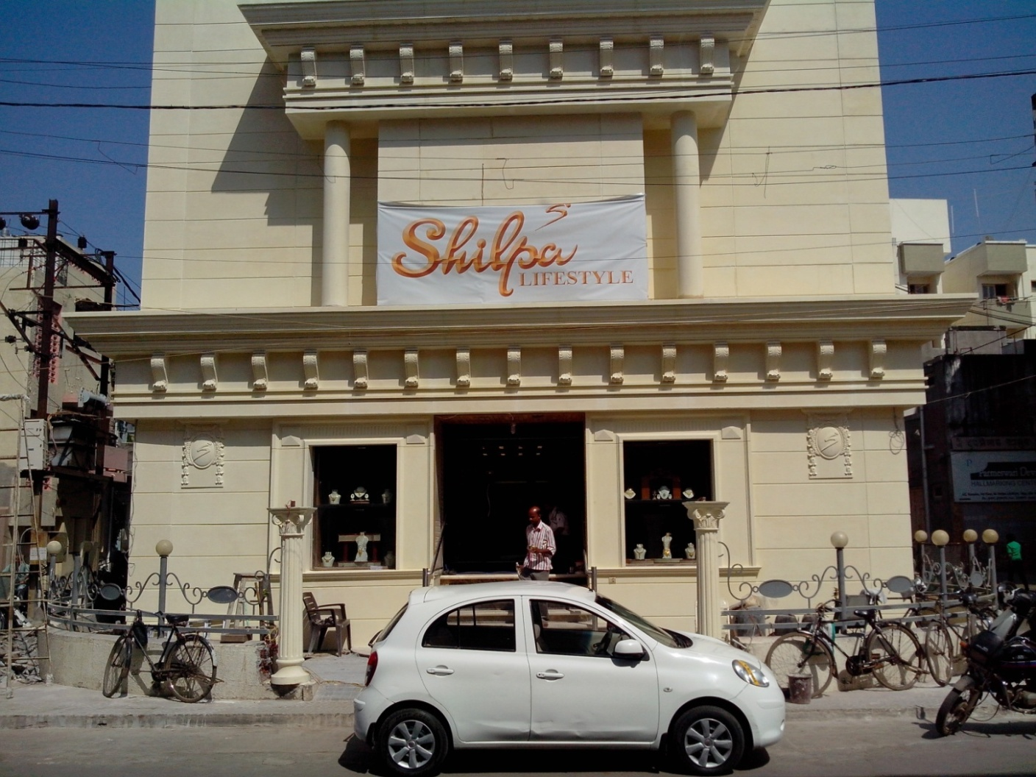
THE RENNOVATED SHOWROOM

Slide 28
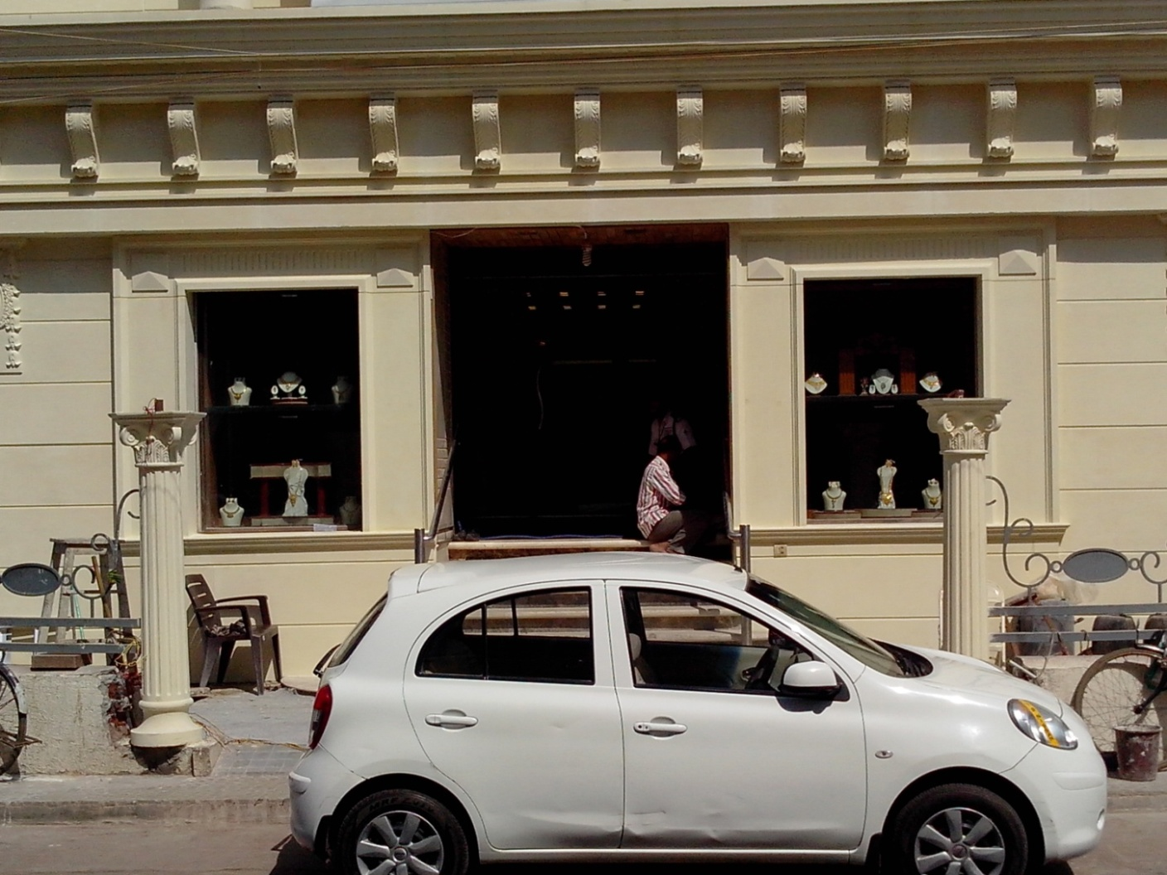
THE RENOVATED SHOWROOM

Slide 29

THE CORNICE

Slide 30
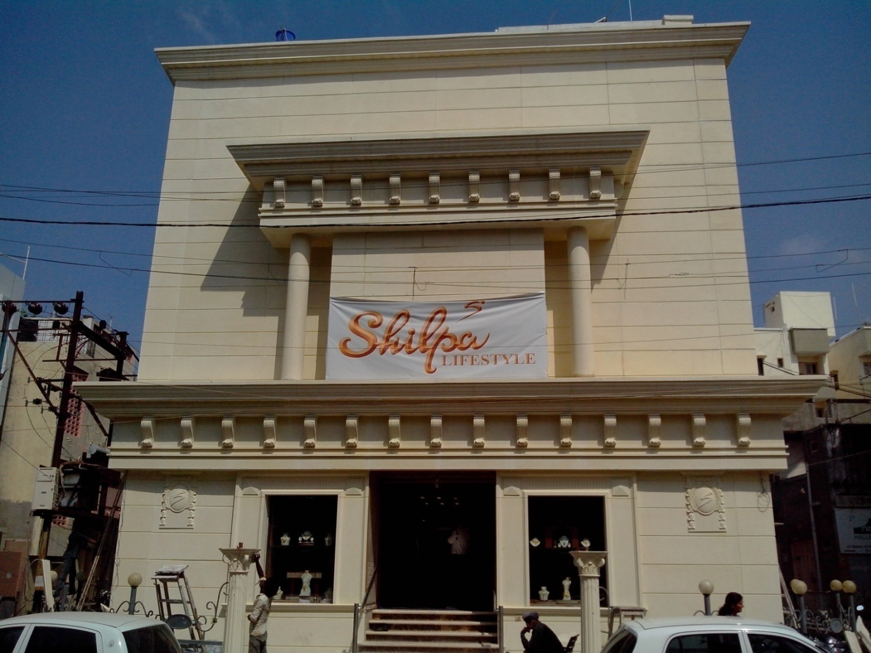
SHILPA JEWELLERS - RAJKOT

Slide 31
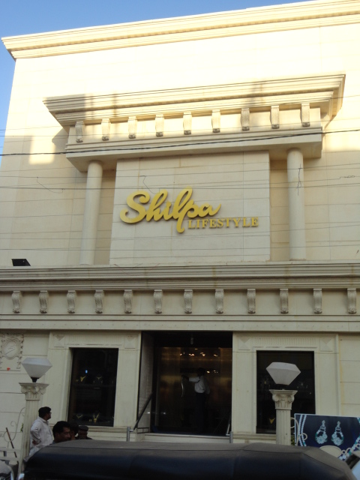

SHILPA JEWELLERS - RAJKOT

Slide 32
Contact details
GFRC FACADES.
GFRC / GRC, GRG CEILINGS & PANELS, FRP WORKS, HIGH END DECORATIVE & ARCHITECTURAL WORKS & ACOUSTIC SOLUTIONS WITH EXPERTISE IN HOME THEATRES
SRIHARI NILKAR
MUMBAI
Mobile: + 91 9867569395
nilkarsrihari@gmail.com

